Slide 1


The Science of
Motivation
Peps Mccrea
@pepsmccrea

Slide 2
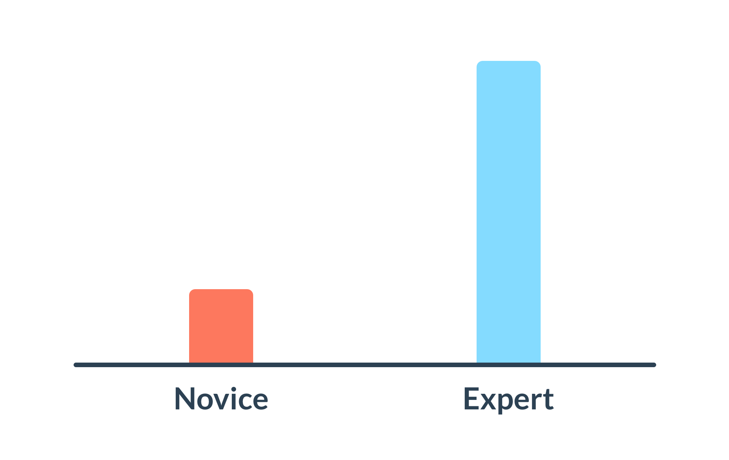
Adapted from: Wiliam (2016) Leadership for Teacher Learning

Slide 3
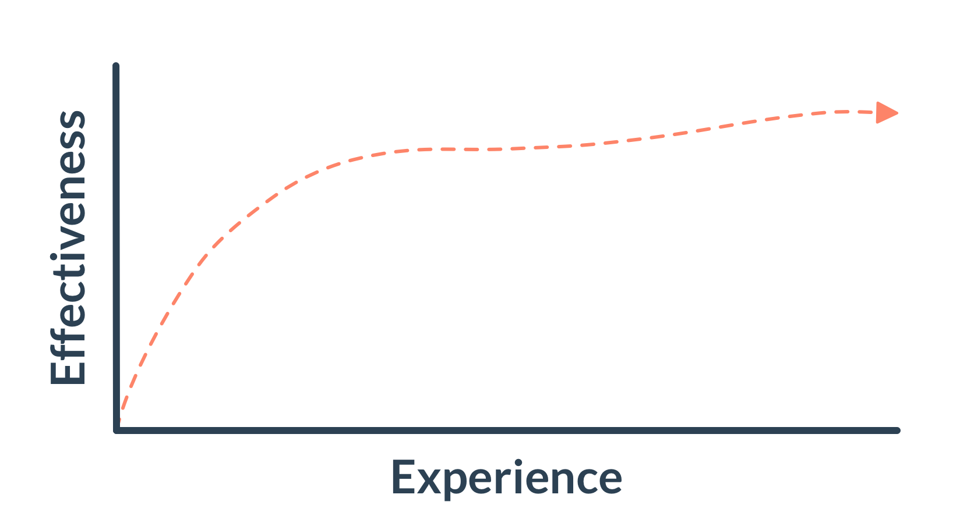
Adapted from: Papay & Kraft (2016) The Myth of the Teacher Performance Plateau

Slide 4
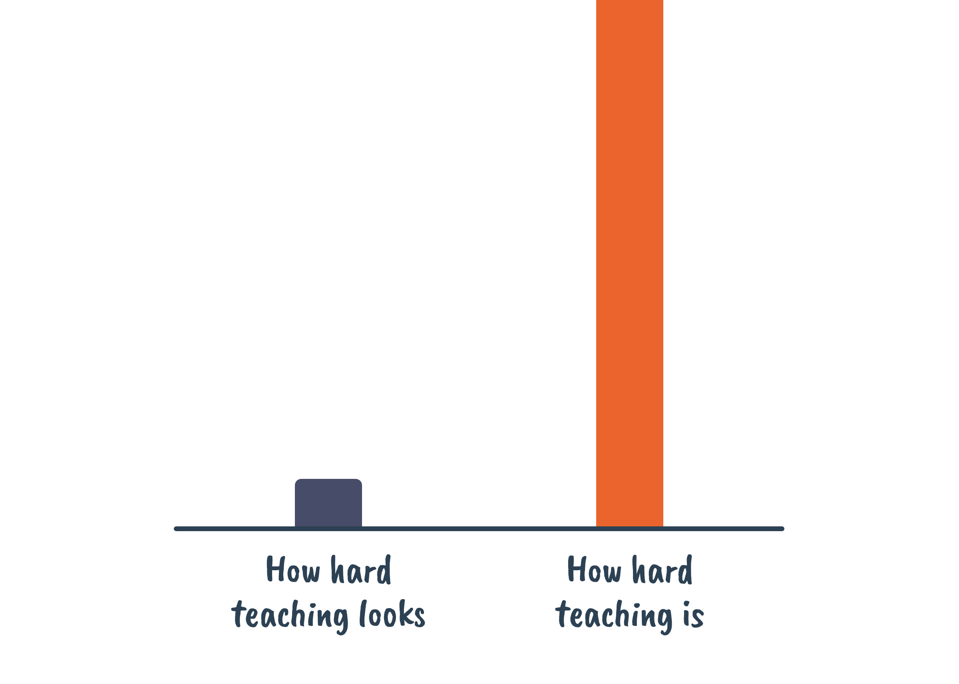

Slide 5


Slide 6
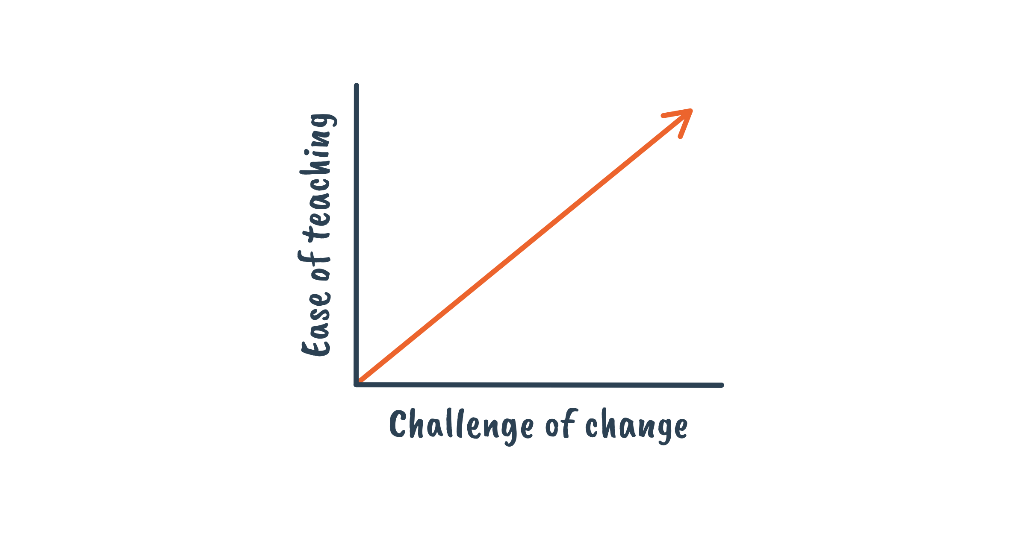

Slide 7


Slide 8
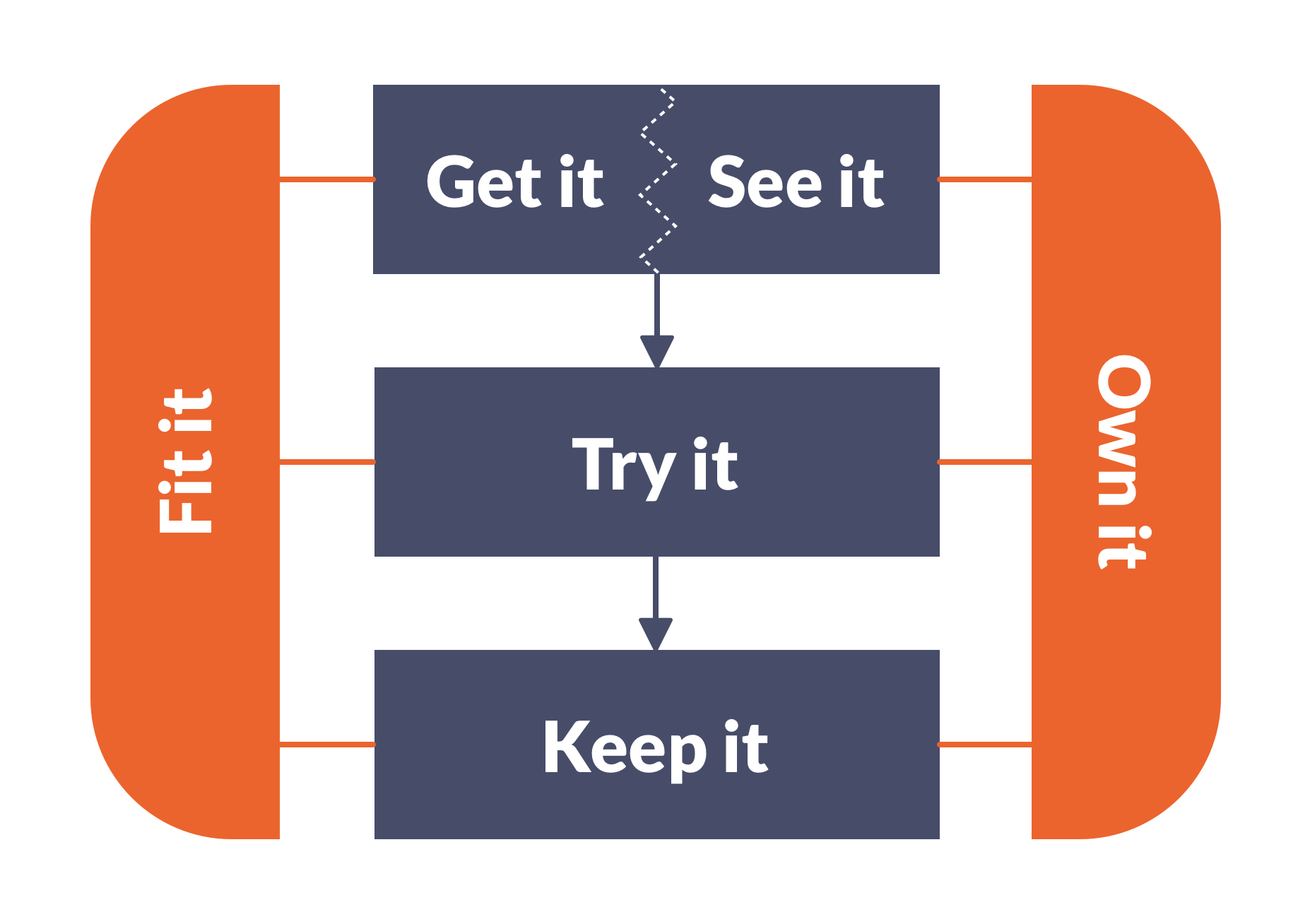

Slide 9
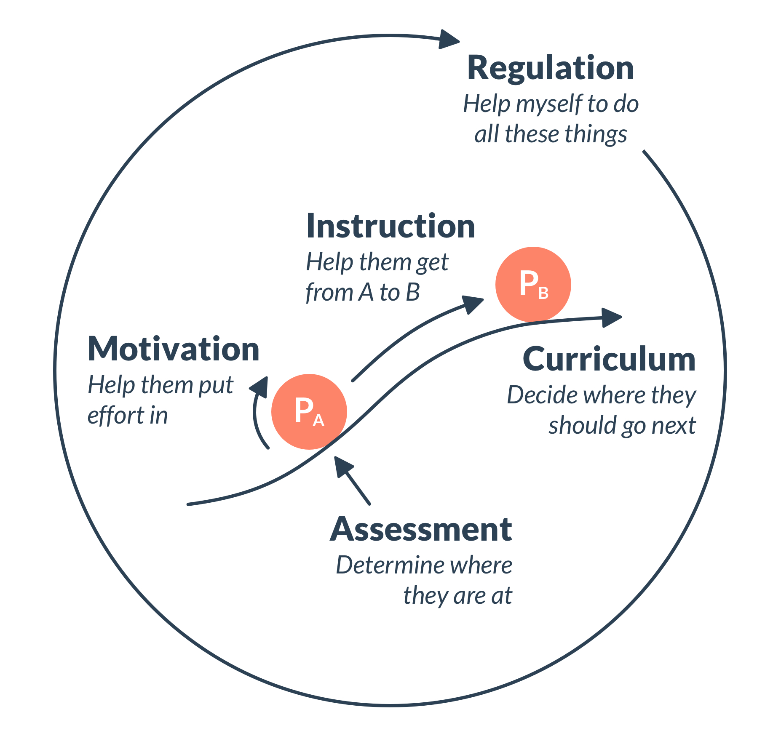

Slide 10

Identify one motivation challenge that you face

Slide 11
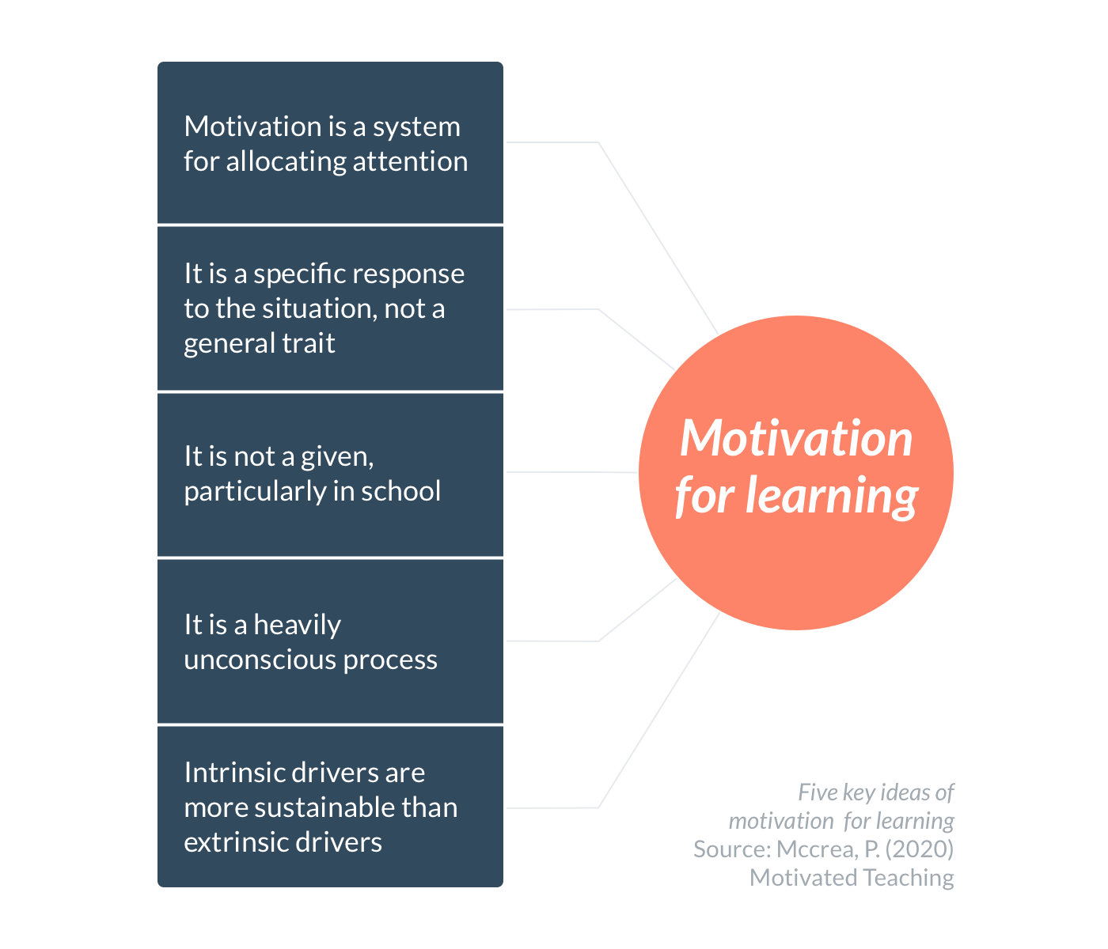

Slide 12
What here might push you to think differently about motivation?

Slide 13
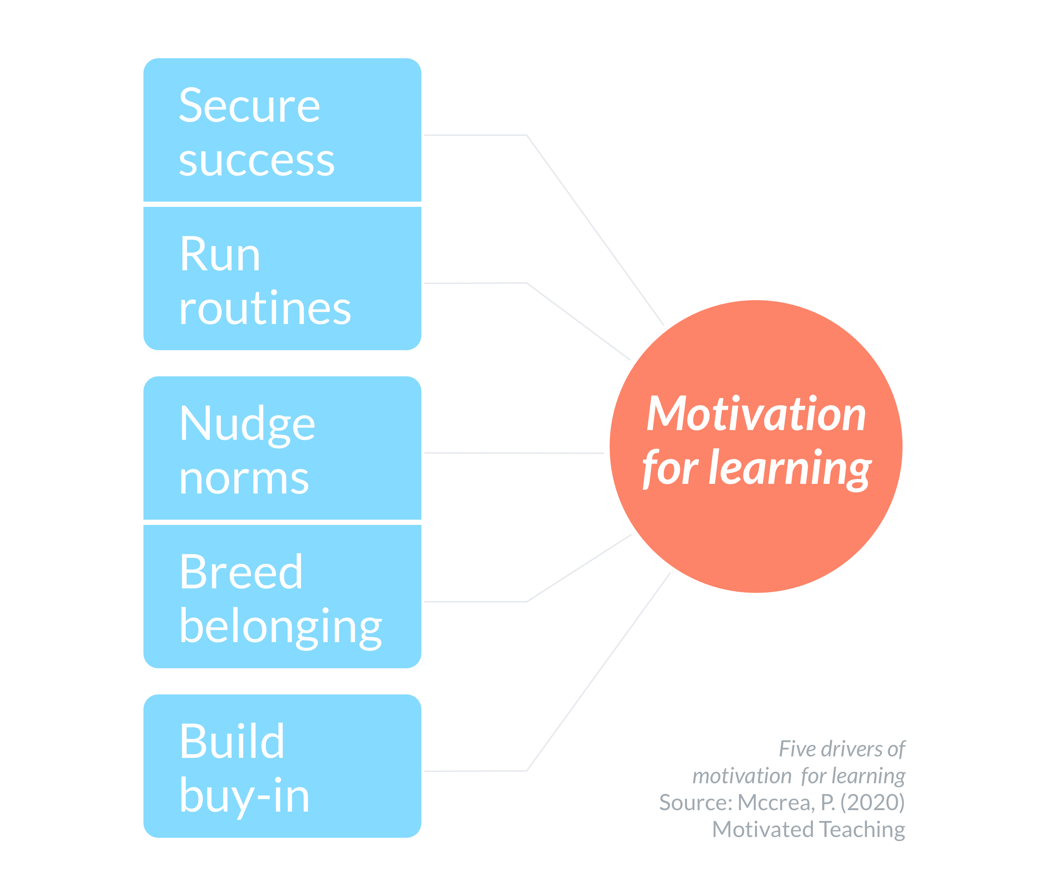

Slide 14
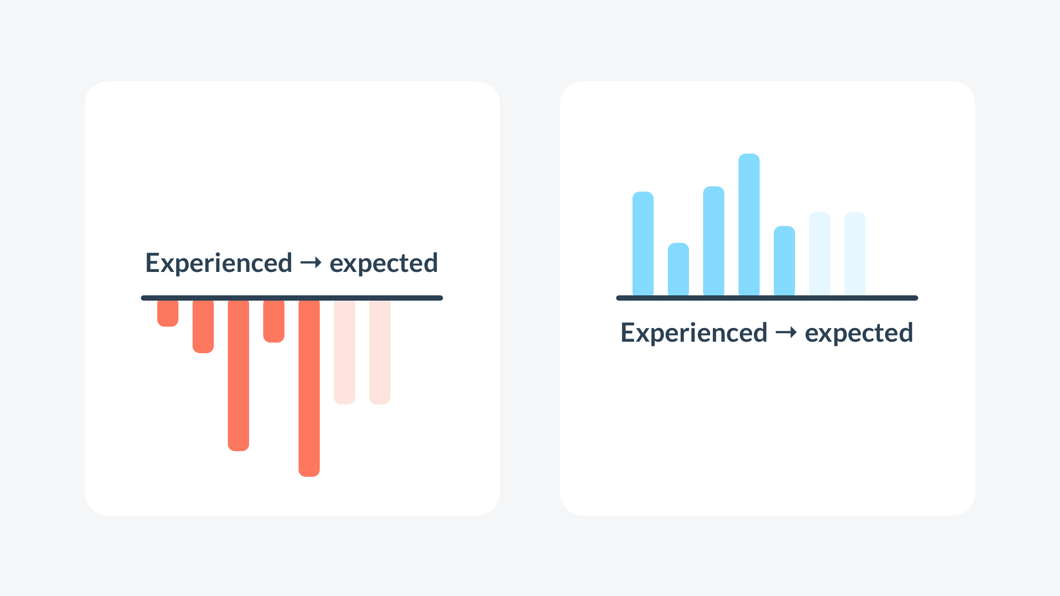

Slide 16
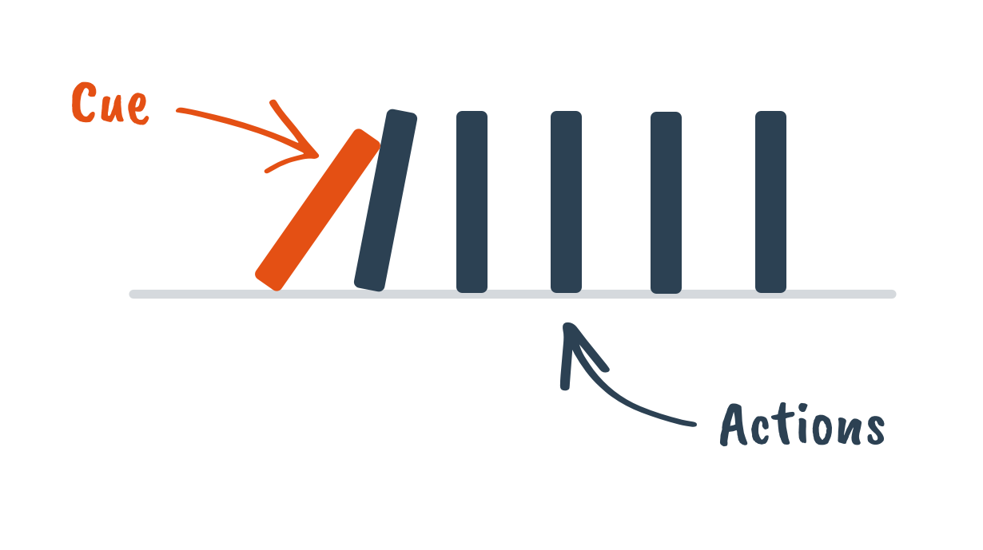

Slide 17
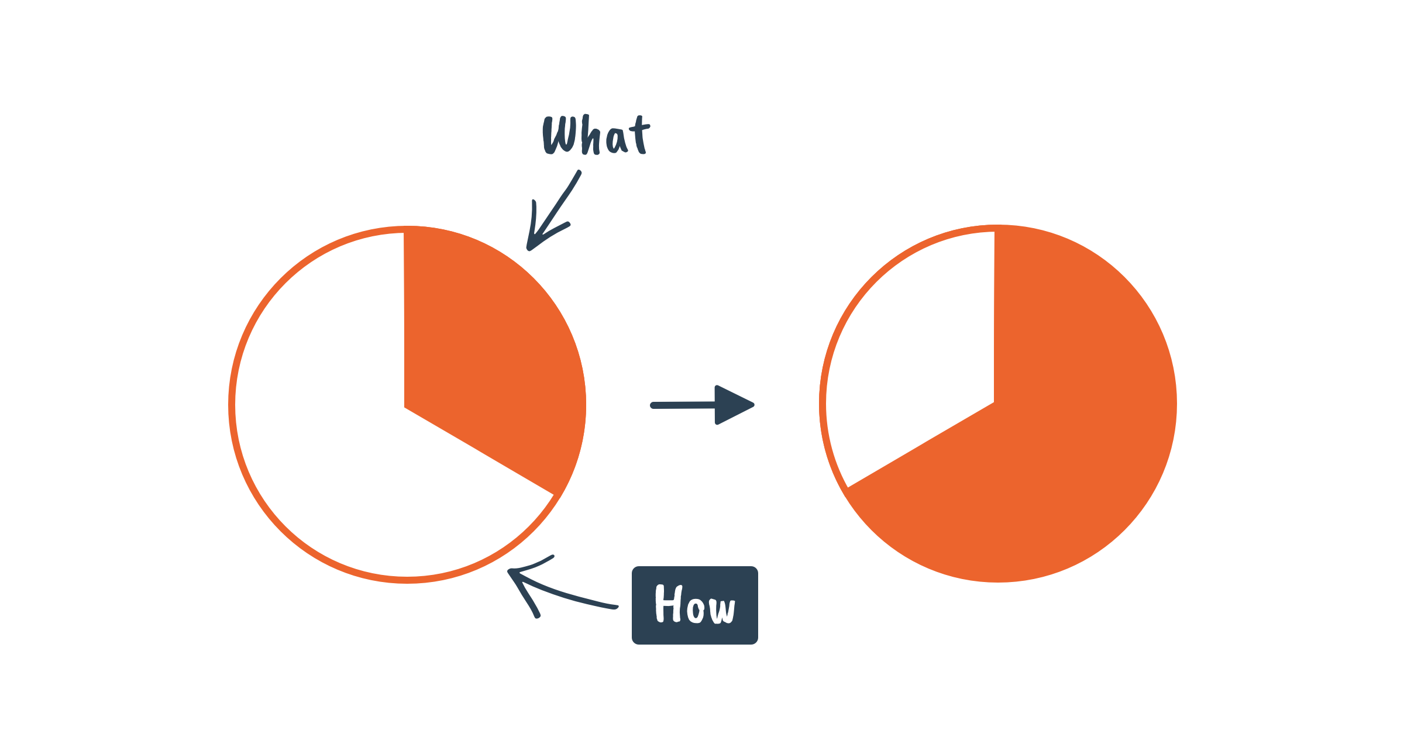

Slide 18
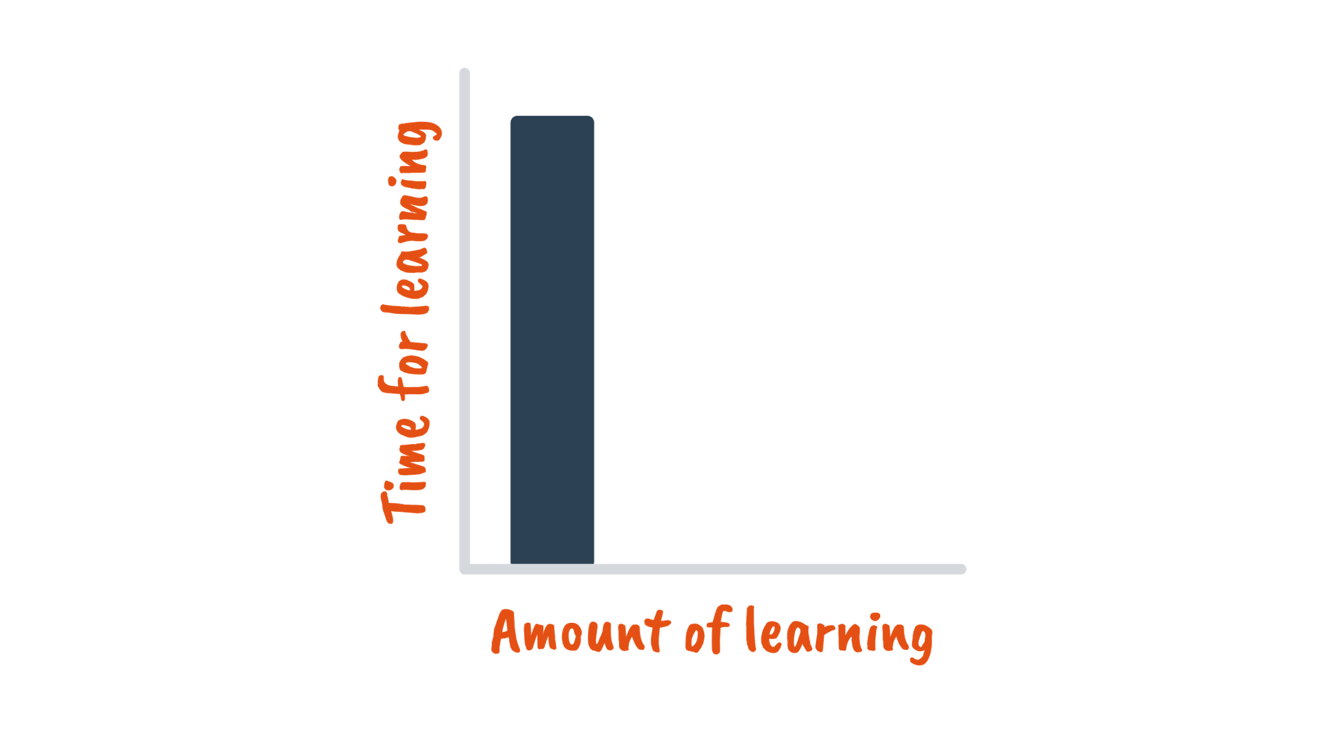
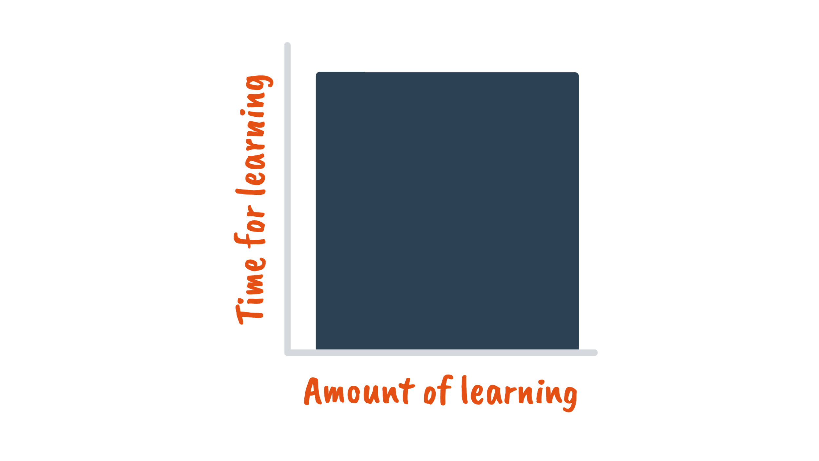

Slide 19
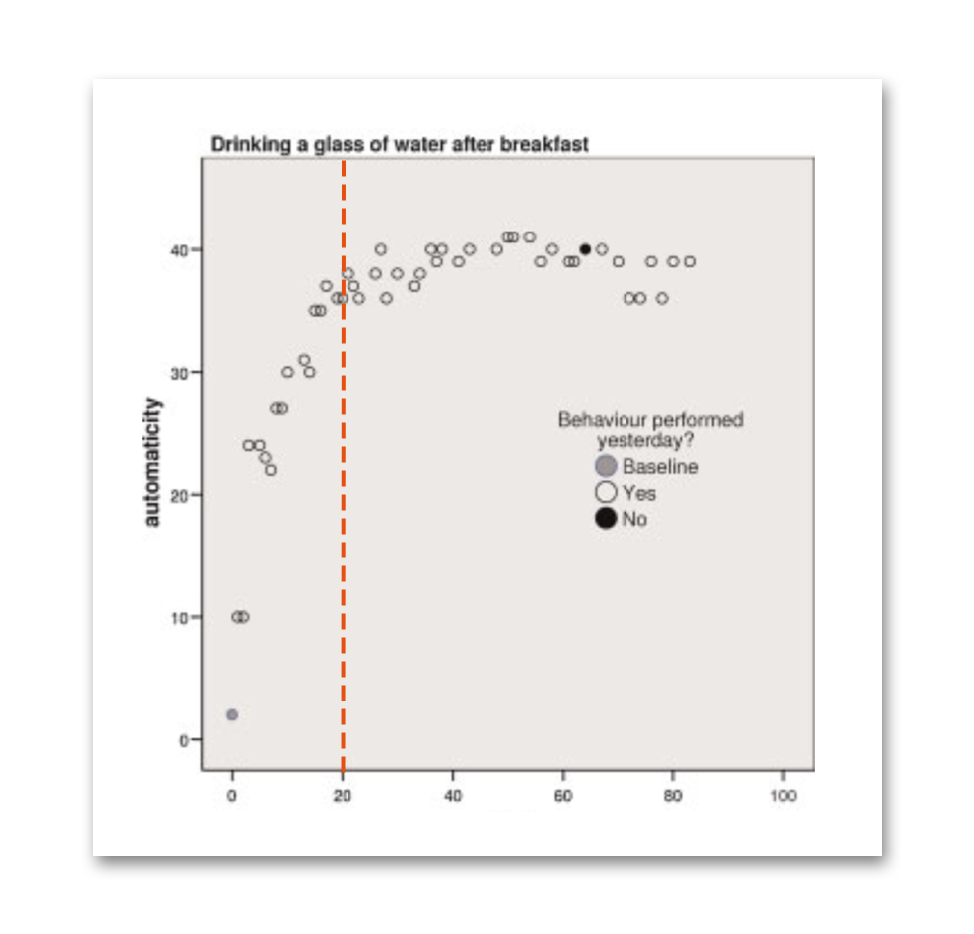
(Gardner et al., 2012)

Slide 20
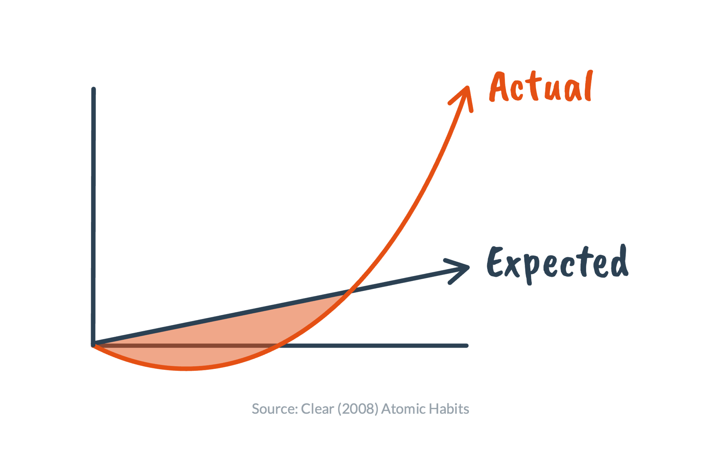

Slide 22


Slide 23


Slide 25


Slide 26


Slide 27


Slide 29
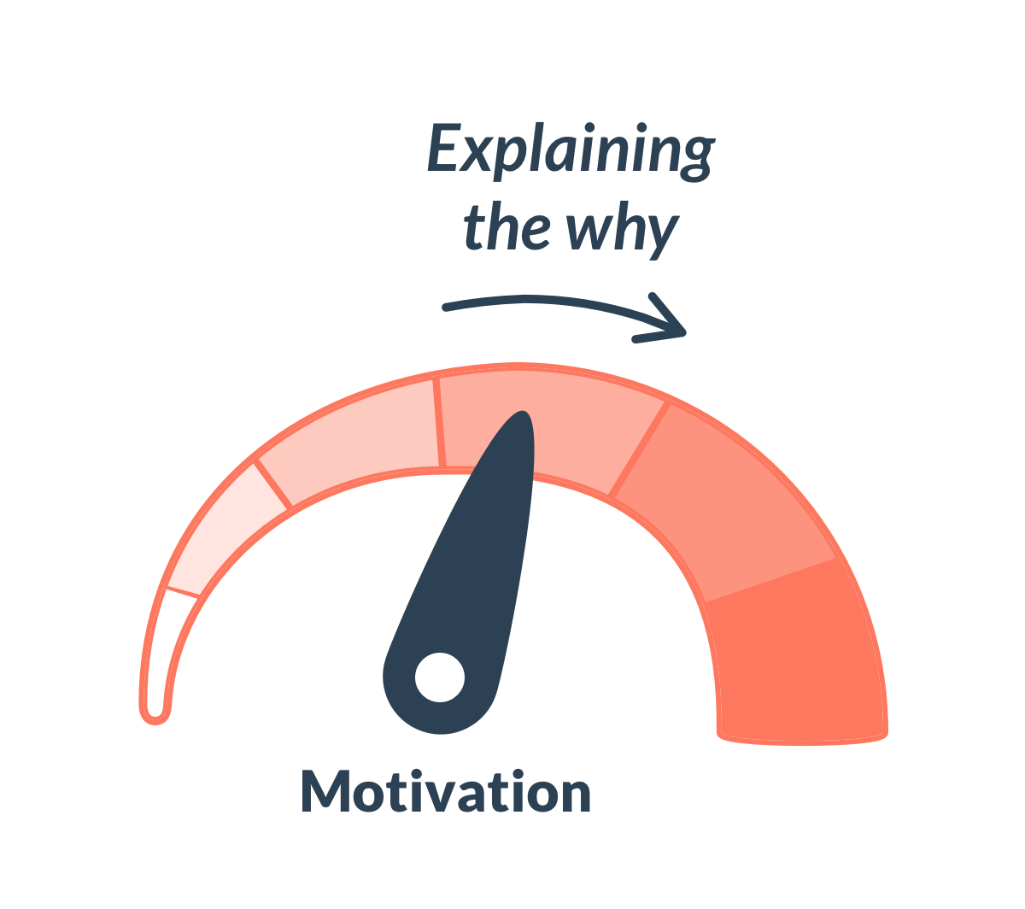

Slide 30
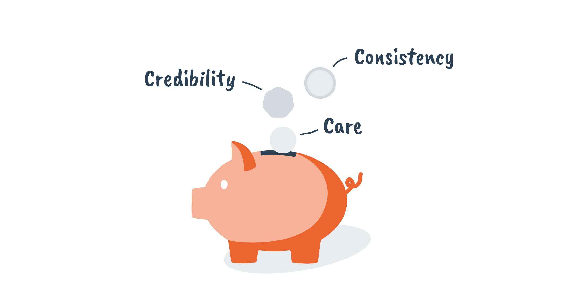

Slide 32
Which strategy has the greatest potential for tackling your challenge?

Slide 33
Which strategy has the greatest potential for tackling your challenge?

Slide 34
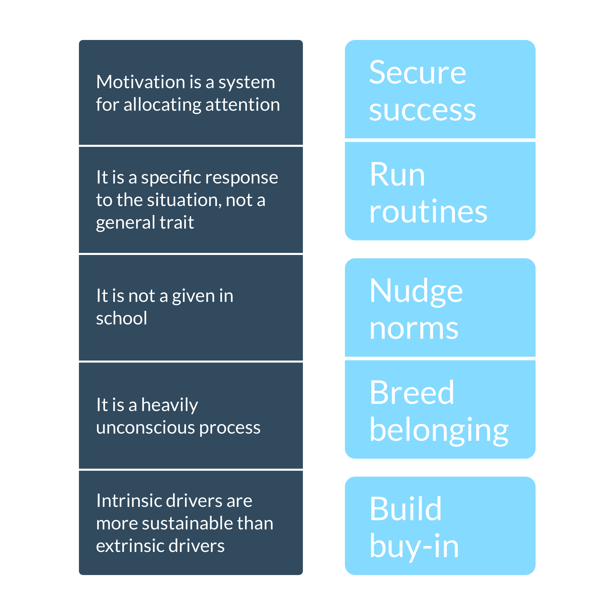

Slide 35


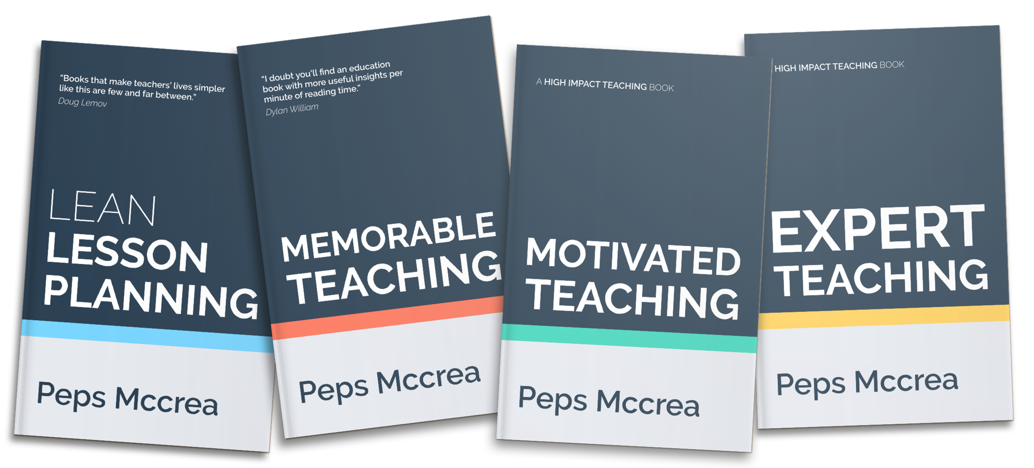

pepsmccrea.com/resources

Slide 36
Peps
Mccrea
@pepsmccrea

